Slide 1


A SystemC-Based Implementation of an IEEE 754 Pipelined Floating-Point Unit with Zynq FPGA Verification
Master’s Thesis Defense
Ashwin Varkey
Master of Science in Computational Engineering
Department Informatik,Friedrich-Alexander-Universität Erlangen-Nürnberg
Advisor: Prof. Dr.-Ing. Dietmar Fey
June 24th 2025

Slide 2
Outline
Introduction
Pipeline Stages
Motivation/Research Objectives
High Level Synthesis and RTL generation
Development Environment /Tools
Results
Verification
Development Flow Stages
FPGA Implementation
Architectural Design
System C modelling approach
Conclusion & Future Work

Slide 3
Introduction
Importance of Floating-Point Units (FPUs)
Fundamental in modern processors for accurate real-number computations.
IEEE 754 standard ensures consistency and precision.
Custom FPU Design
Uses RISC-V RV32F extensions for FPU pipeline (adder, multiplier, subtractor, divider)
Faster design cycles using C/C++/SystemC and bridges gap between algorithm and hardware.
Design & Verification Methodology
SystemC modelling → RTL design → FPGA implementation
Custom testbenches
Target Applications
Embedded systems with strict speed/power/resource constraints.

Slide 4
Motivation / Objectives
Trade-offs
Balancing accuracy, latency, and resource efficiency
IEEE 754 Compliance Complexity
Managing division algorithms and special cases (NaN, infinity, denormals)
HLS to Hardware Translation
Bridging C/C++/SystemC to HDL design paradigms
Verification Coverage
Comprehensive testing across normal and edge case scenarios
FPGA Platform Integration
Managing pinout, clock frequency, and board compatibility constraints

Slide 5
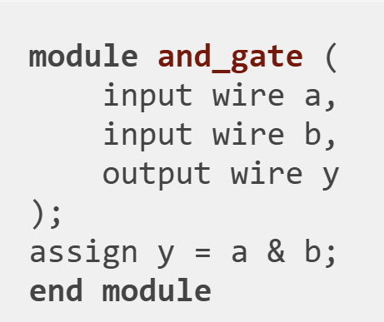
Development Environment
High-Level Modelling Environment
• C++ Compiler: GCC 9.3.0 with C++14 standard support for compilation and linking
• SystemC Library: Version 2.3.3, providing transaction-level modelling constructs and simulation kernel
RTL Design and Synthesis Tools
• Xilinx Vivado 2019.2: Primary tool for RTL synthesis, implementation, and FPGA targeting
• Intel Compiler for SystemC (ICSC): High-level synthesis tool that translates synthesizable SystemC code into System Verilog.
Verification and Analysis Tools
• GTKWave 3.3.104: Waveform visualization and signal analysis for debugging
• RISC-V GNU Toolchain: Cross-compiler and assembler for generating test programs
• Spike RISC-V ISA Simulator: Reference implementation for golden model comparison
Development Infrastructure
• Hardware Platform: Xilinx Zynq XC7Z020 evaluation board for implementation validation

Slide 6
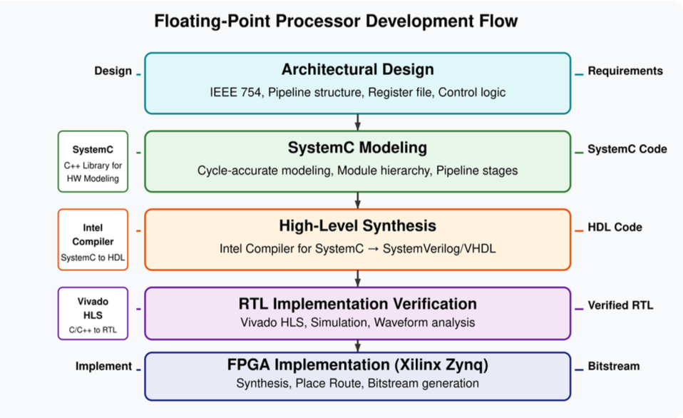
Development Flow Stages

Slide 7
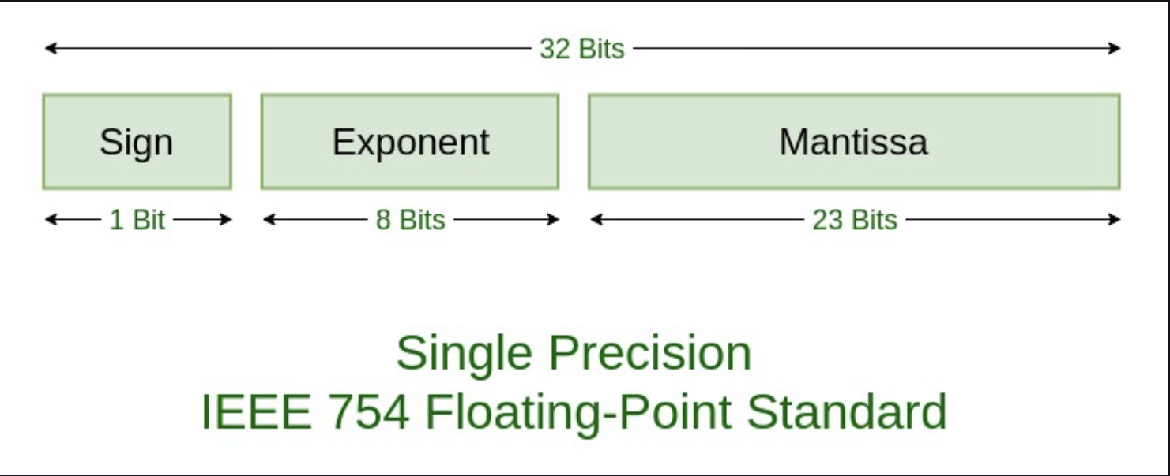
Architectural Design
Handles exponent alignment, normalization, and rounding logic
IEEE 754 Single Precision Format
32-bit implementation (1 sign, 8 exponent, 23 significand bits)
Operations: Addition, Subtraction, Multiplication, Division
Comprehensive Standards Compliance
Special cases: Zero, Infinity, NaN, Denormals
Round-to-nearest (ties to even) rounding mode
Exception handling: Overflow, Underflow, Division by Zero
Special Cases:
Zero: Exp=0, Sig=0
Denormal: Exp=0, Sig≠0
Infinity: Exp=255, Sig=0
NaN: Exp=255, Sig≠0

Slide 8
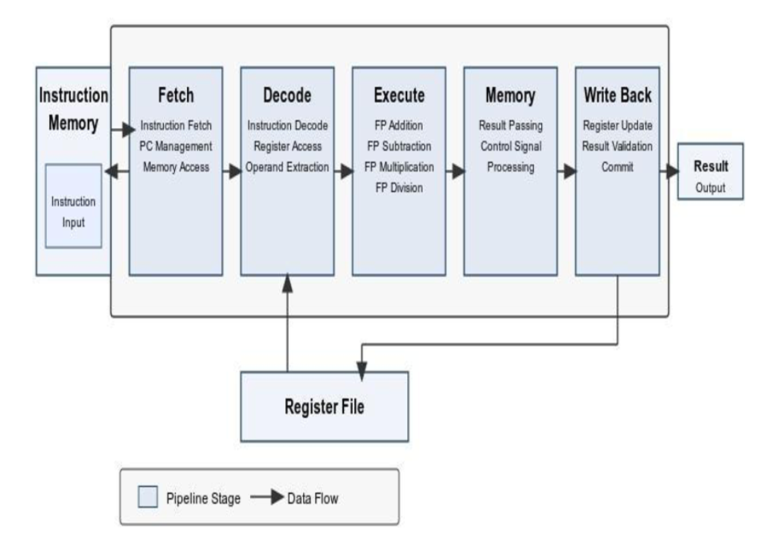
Pipeline Stages
IF (Fetch): Retrieve instruction from memory.
ID (Decode): Decode opcode, read operands.
EX (Execute): FPU operation (add/sub/mul/div).
MEM (Memory): Pipeline buffer (minimal memory ops).
WB (Writeback): Write result to register file.
[Module] → (Ports) → [Signals] → [Processes]
↑
[Clock/Events]
[IF] → [ID] → [EX] → [MEM] → [WB] (Linked via registers/ports)

Slide 9
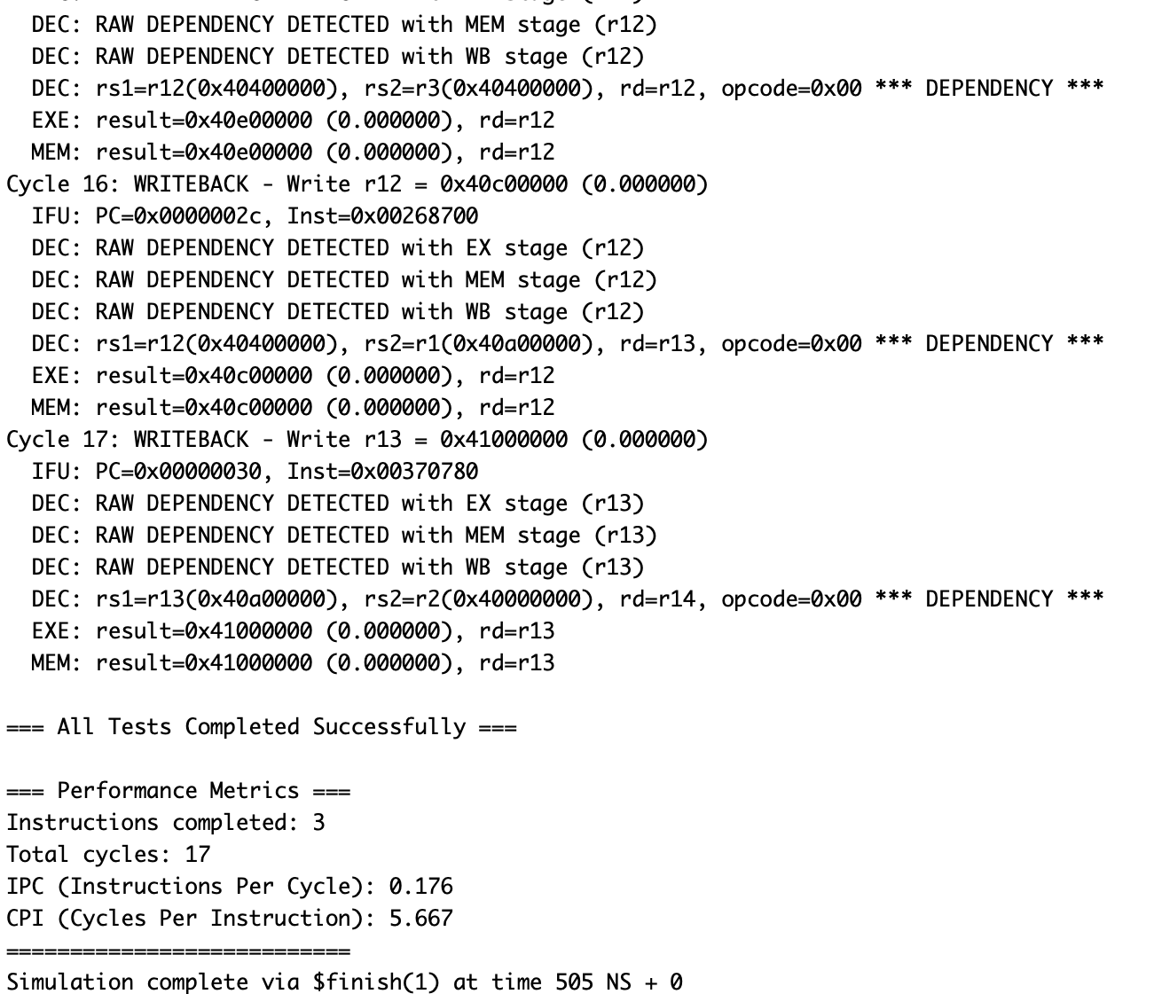
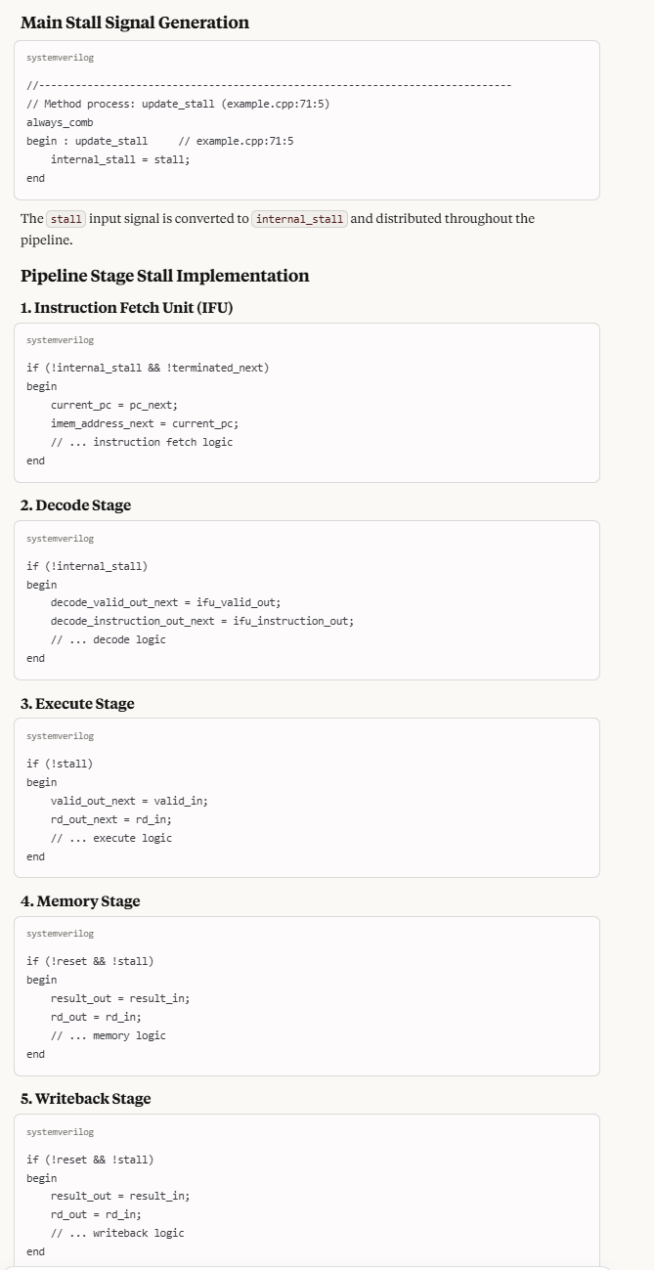
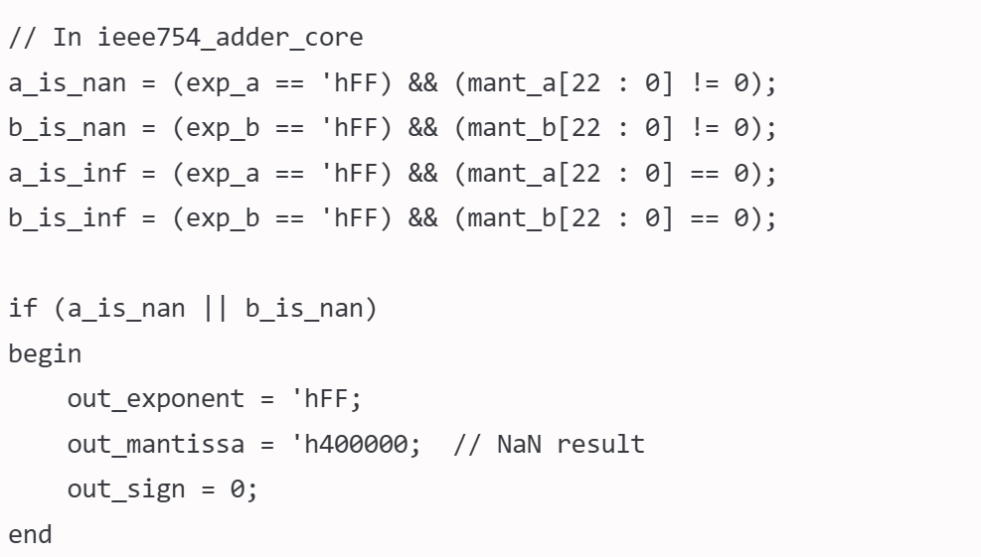
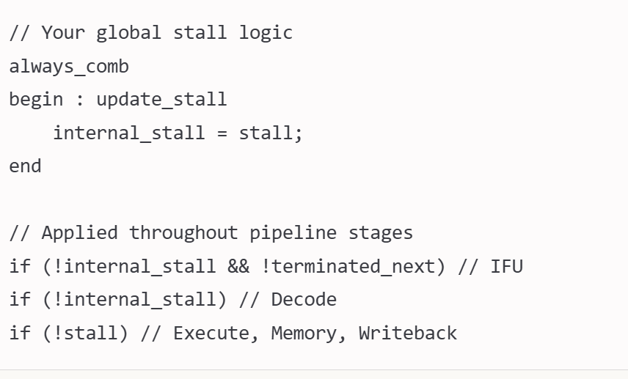
Architectural Design
Pipeline Management
External stall
Data dependency detection with forwarding logic to minimize stalls
IEEE 754 exception handling for overflow, underflow, and division errors

Slide 10
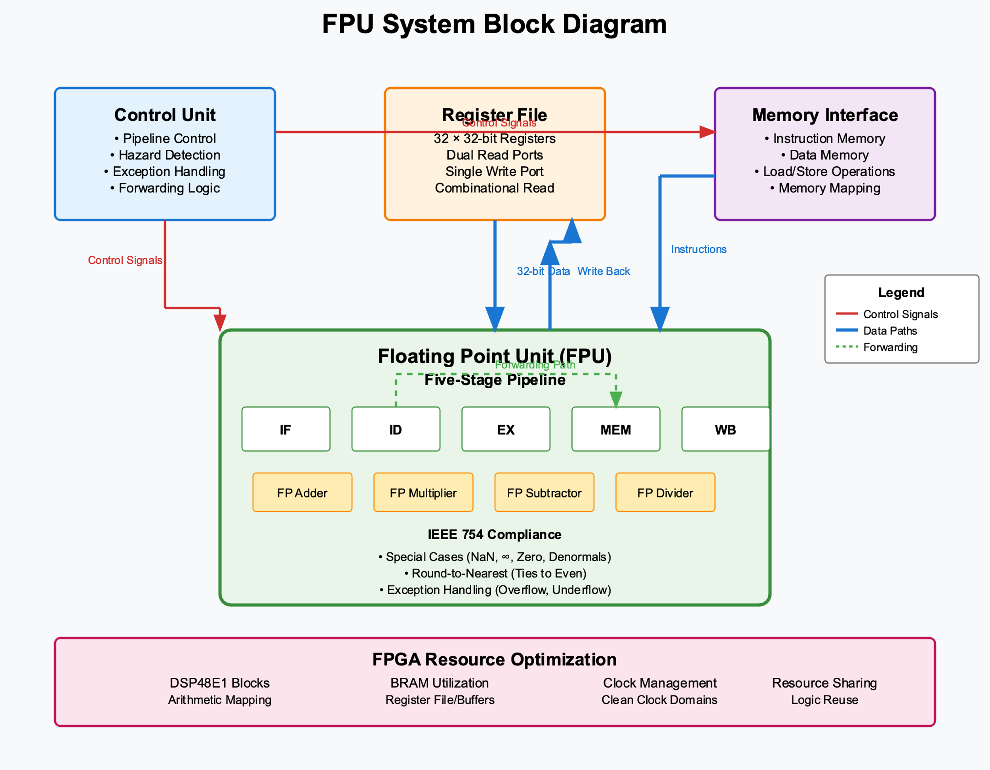
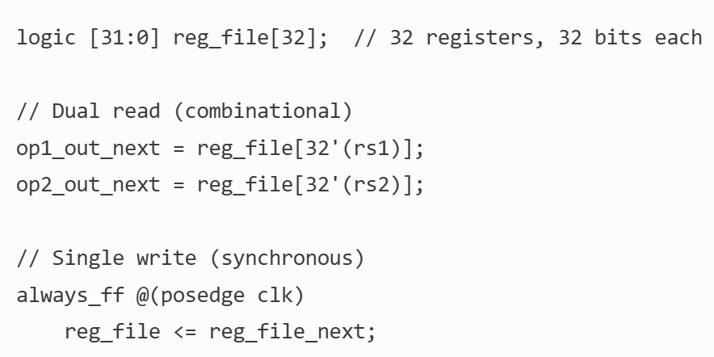
Architectural Design
Register File Architecture
32 floating-point registers (32-bit each)
Dual-read, single-write port configuration
Combinational reads with synchronous clock-edge writes

Slide 11
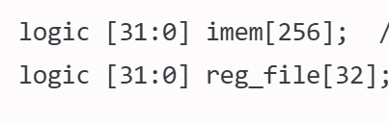
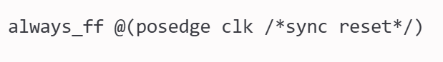
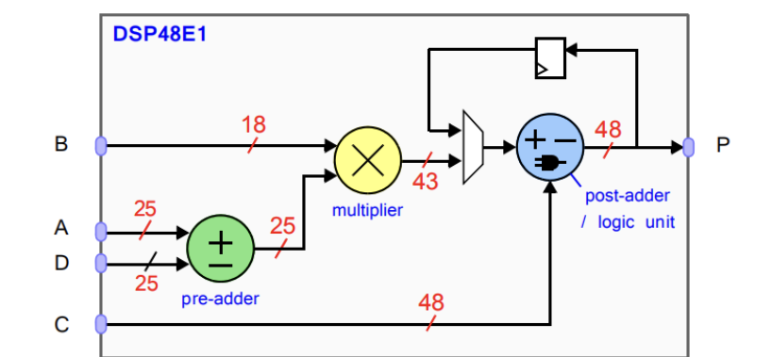
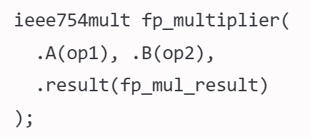
Architectural Design
FPGA Resource Optimization
DSP48E1 blocks for efficient arithmetic unit mapping
BRAM utilization for register files and data buffers
Clean clock domain management with target frequency achievement

Slide 12
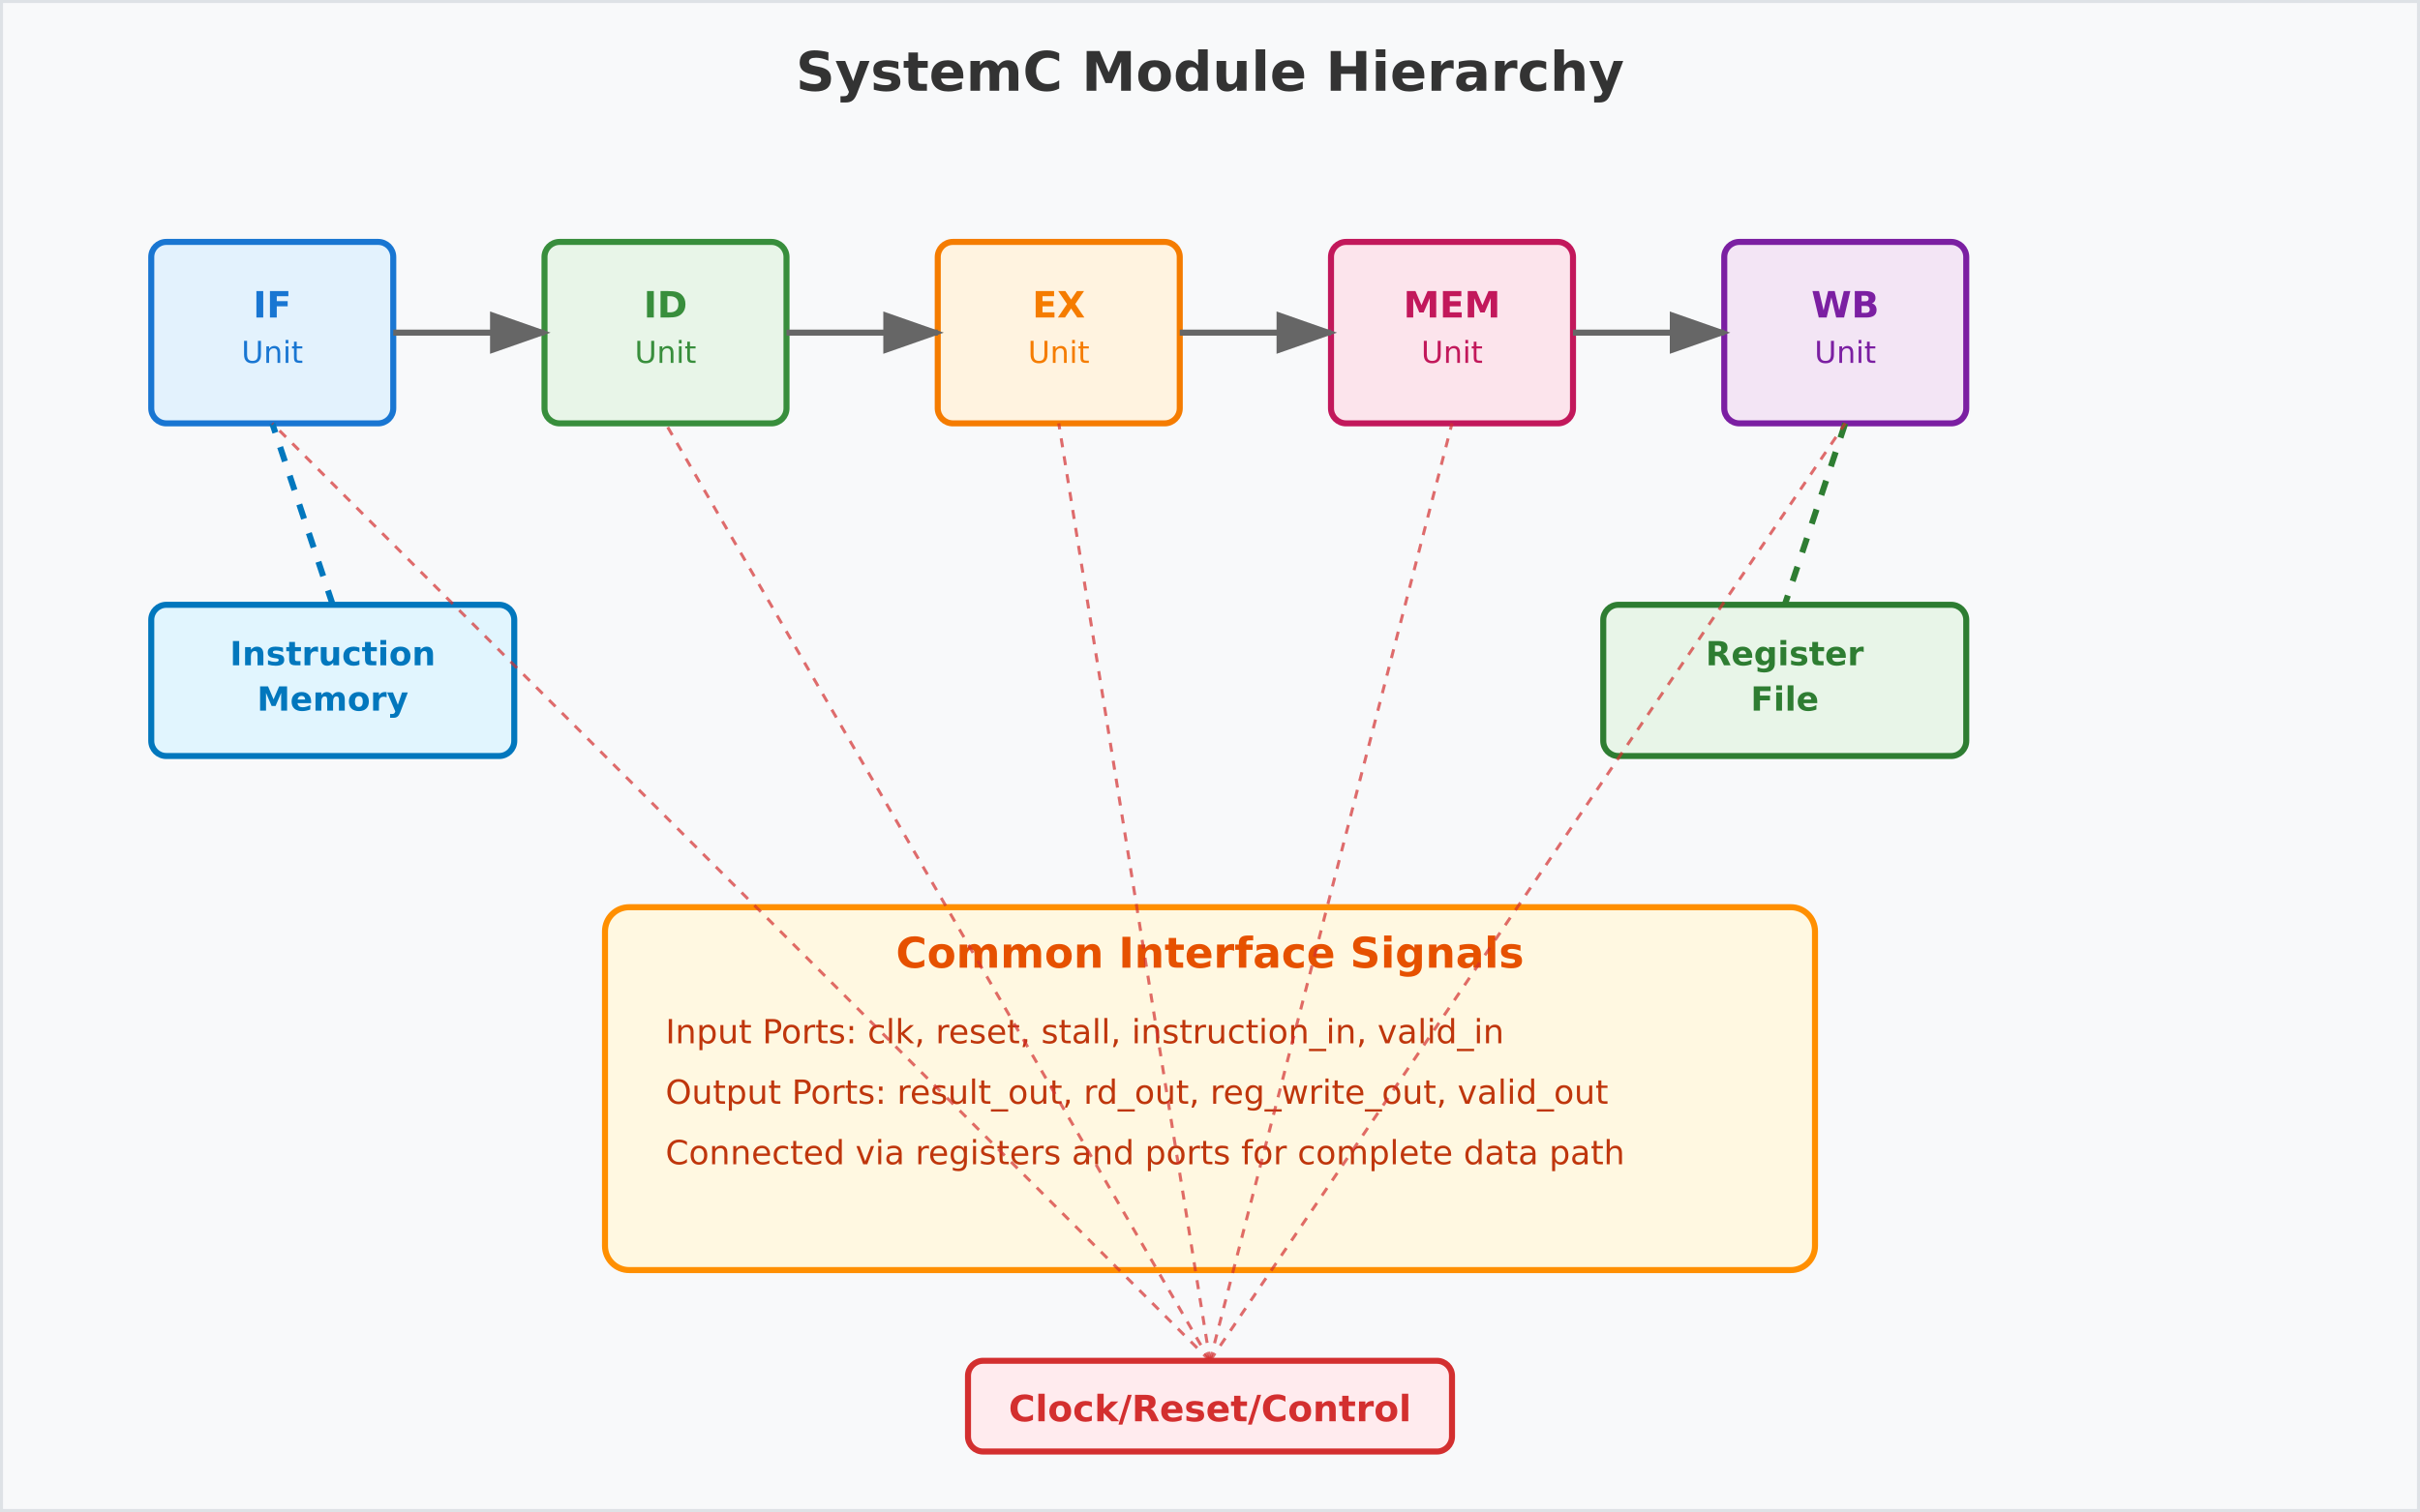
SystemC Approach
C++-Based HDL: Bridges software/hardware design.
Key Constructs:
Modules : Hardware building blocks.
Ports & Signals: Inter-module communication (like wires).
Processes: Parallel "workers" (triggered by clocks/events).
Clocks/Events: Synchronize timing (e.g., flip-flops).
Interface Definitions
- Standardized SystemC ports and signals
-Consistent communication between pipeline stages
-Facilitates modular design and verification
Process Structure
-Reset section: Initialization and configuration
-Infinite loop: Communication and computation cycles
-wait() statements: Virtual-clock boundaries for HLS optimization

Slide 13
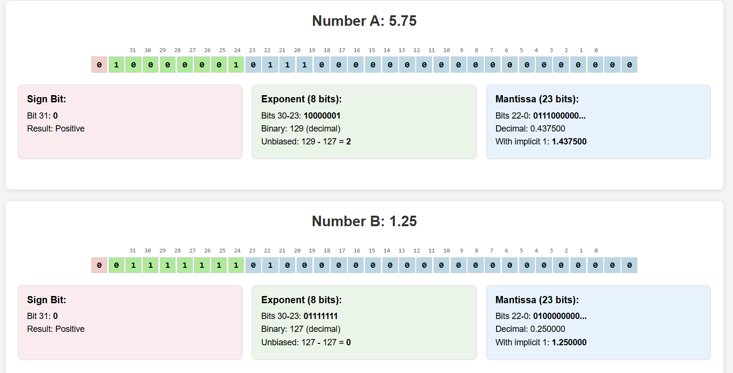
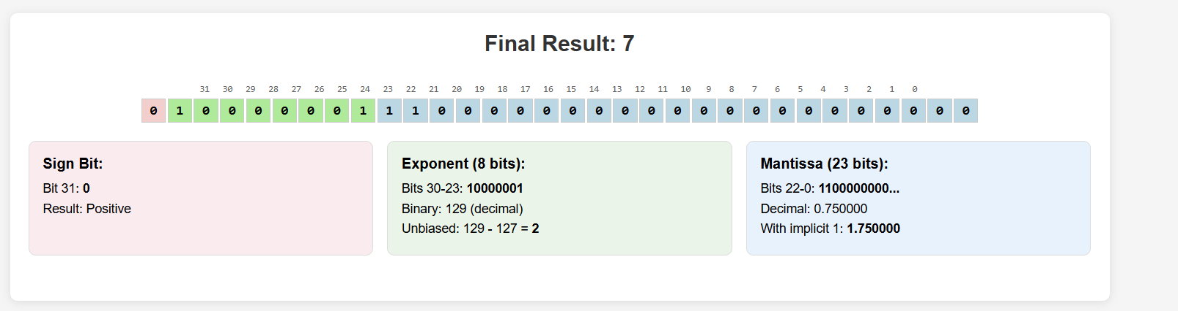
SystemC Approach
IEEE 754 Adder

Slide 14
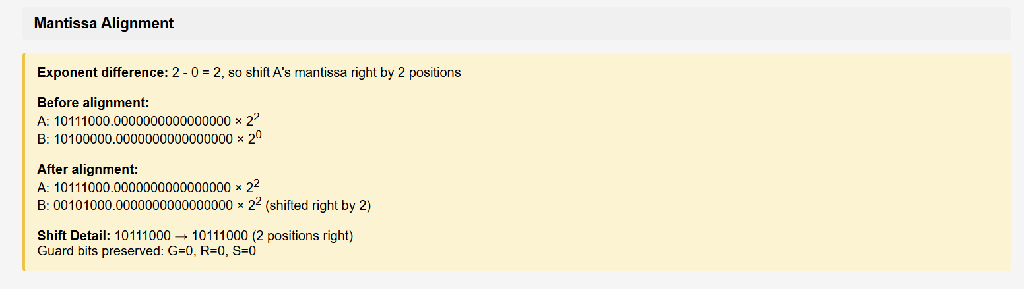
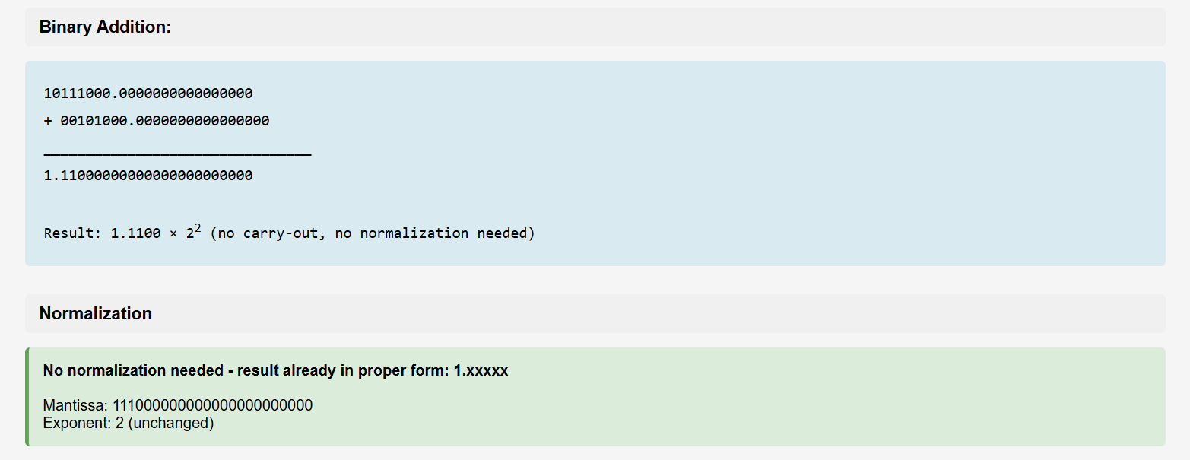
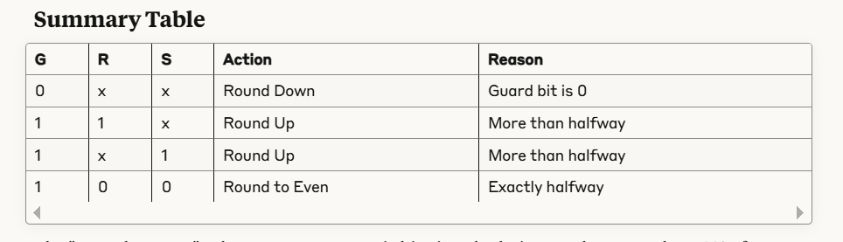

Slide 15
SystemC Approach
IEEE 754 Multiplier
Multiplication
Sign: A_sign ^ B_sign (XOR)
Exponent: A_exp + B_exp - 127 (bias adjustment)
Mantissa: Full 24-bit multiplication
Normalization: Adjust for mantissa overflow
Rounding: Apply IEEE 754 rounding rules
Special Cases
Non-Restoring Division Algorithm
Sign: A_sign ^ B_sign (XOR)
Exponent: A_exp - B_exp + 127 (bias adjustment)
Mantissa: Iterative 25-step division
Normalization: Adjust result format
Rounding: Apply IEEE 754 rounding rules
Special Cases: Handle division by zero

Slide 16
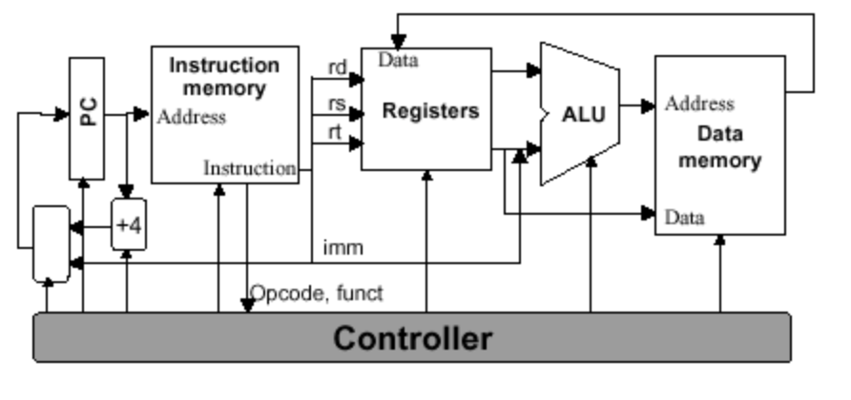
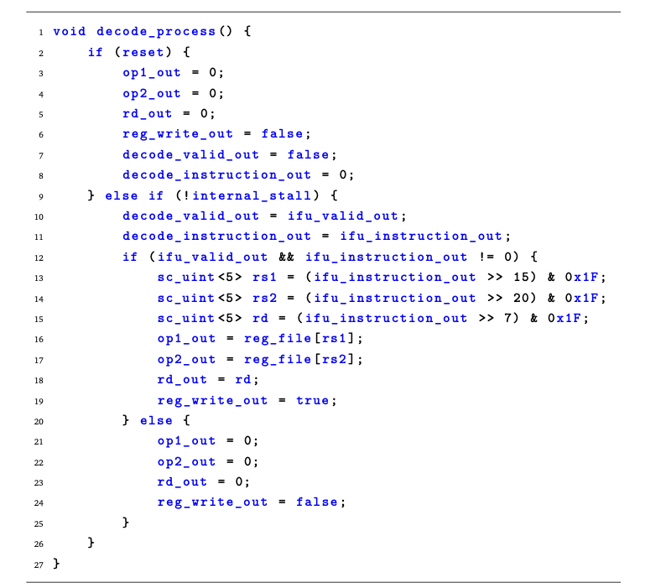
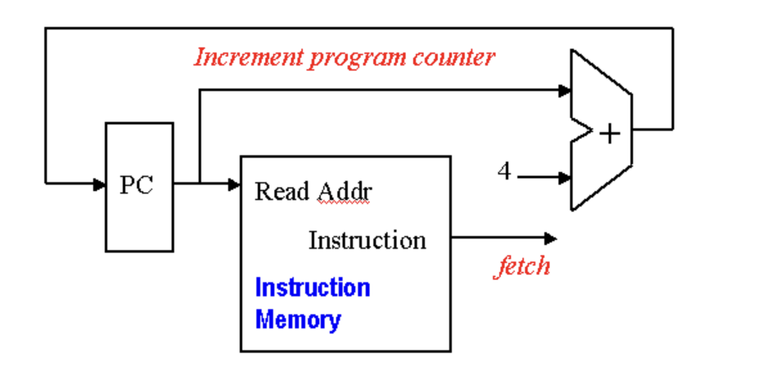
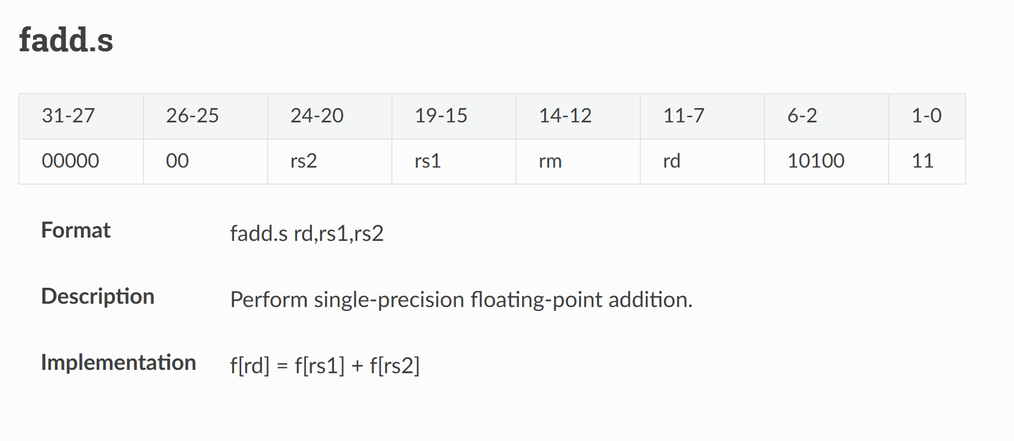
SystemC Approach
Pipeline
Instruction Fetch (IF)
Manages Program Counter (PC += 4).
Reads instructions from memory.
Terminates on dedicated halt instruction 32'hFFFFFFFF or 0
Decode Stage (ID)
Extracts register addresses using bit masking operations
rs1 = (instruction >> 15) & 0x1F , rs2 = (instruction >> 20) & 0x1F , rd= (instruction >> 7) & 0x1F
Instruction decoding and parsing
Register operand identification and retrieval
Control signal generation
Validity signal propagation
Reads operands from register file (reg_file[rs1]).

Slide 17
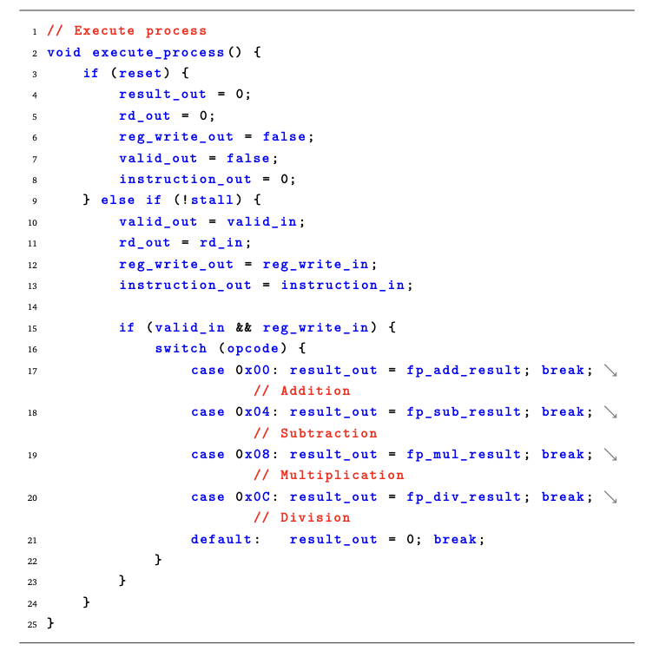
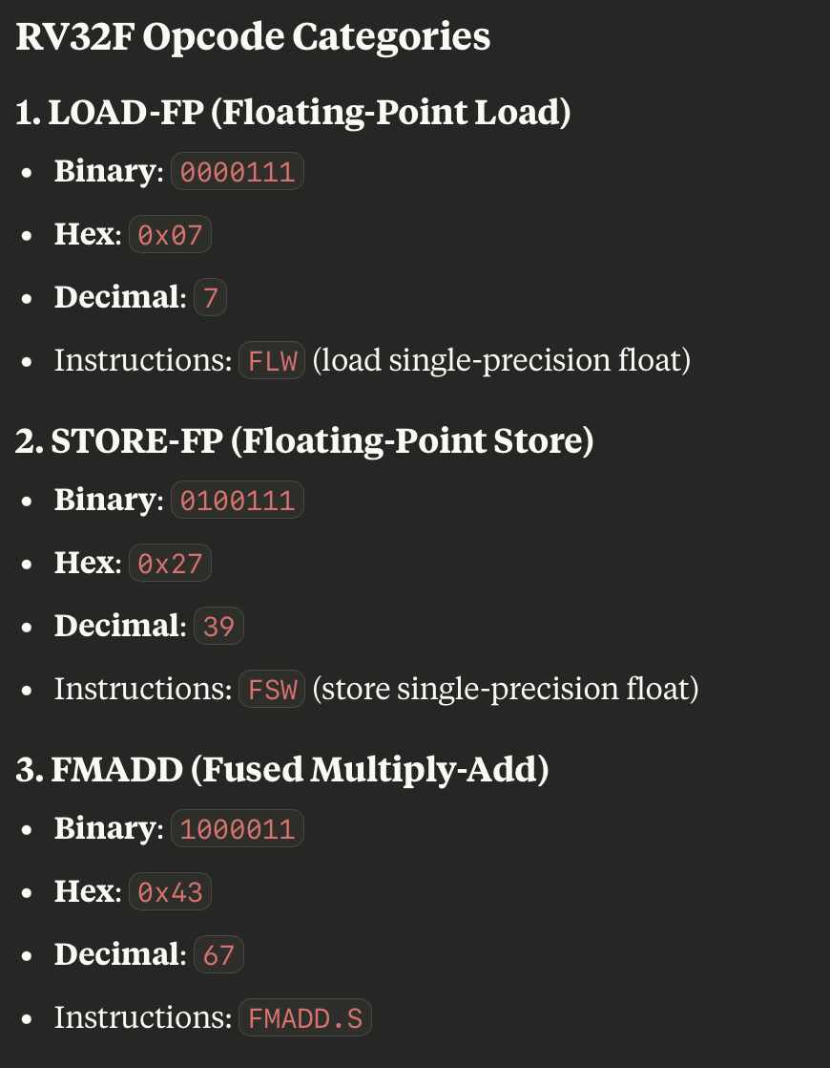
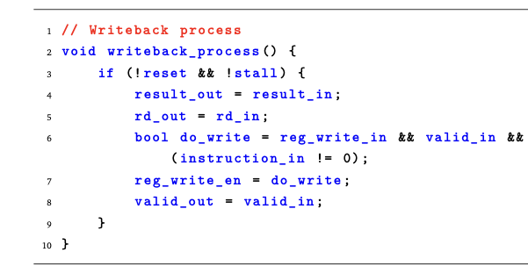
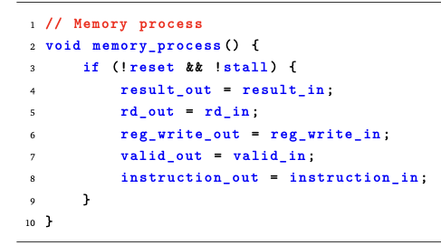
SystemC Approach
Pipeline
Execute Stage (EX)
Switch statement selects FP units: 0x00 (ADD), 0x04 (SUB), 0x08 (MUL), 0x0C (DIV)
Four dedicated floating-point units process operations
Exception Handling
Forwards results through result_out port
Memory Stage (MEM)
Passthrough Role
Propagates control signals (reg_write_out, valid_out)
Functions as pipeline register for FP-focused design
Writeback Stage (WB)
Updates architectural state with execution results
Performs register write control and result validity checking
Completes instruction execution cycle

Slide 18
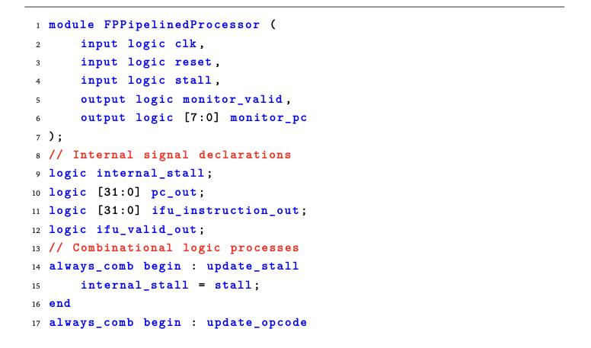
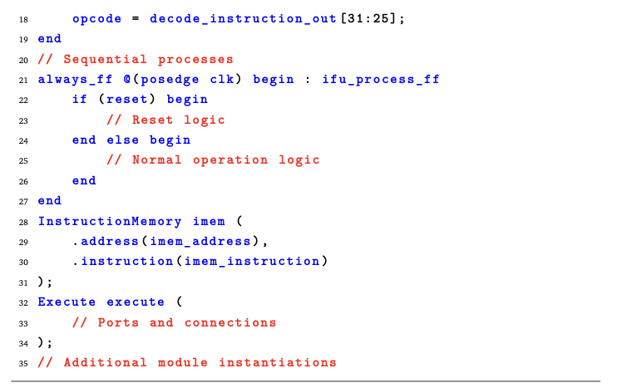
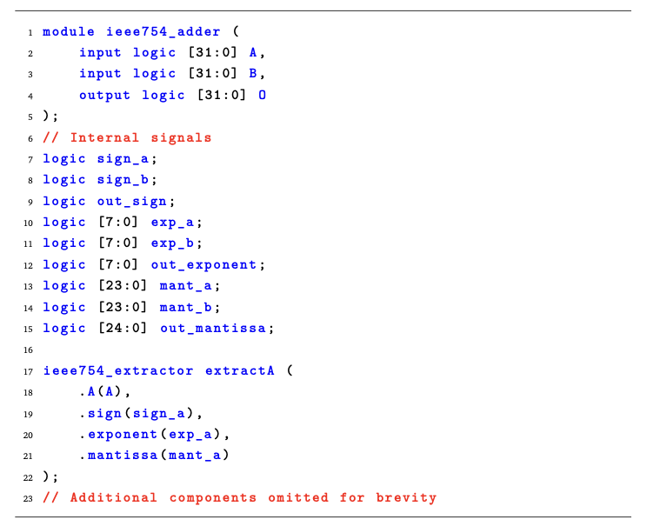
High-Level Synthesis and RTL Generation
Intel SystemC Compiler
Automated SystemC to SystemVerilog translation
Reduces manual conversion errors and development time
Enables faster prototyping and architecture experimentation
Synthesis-Ready SystemC Design
Synthesizable constructs: Hardware-equivalent features only
Explicit clocking: Well-defined clock edges, no gated clocks
Resource-aware modeling: FPGA-optimized memory/DSP usage
Bit-accurate modeling: Defined widths, prevent overflow/underflow
Generated Verilog Structure
Process translation: SystemC → always_comb/always_ff blocks
Signal preservation: SystemC signals → Verilog wires/registers
Module hierarchy: Maintained structural integrity

Slide 19
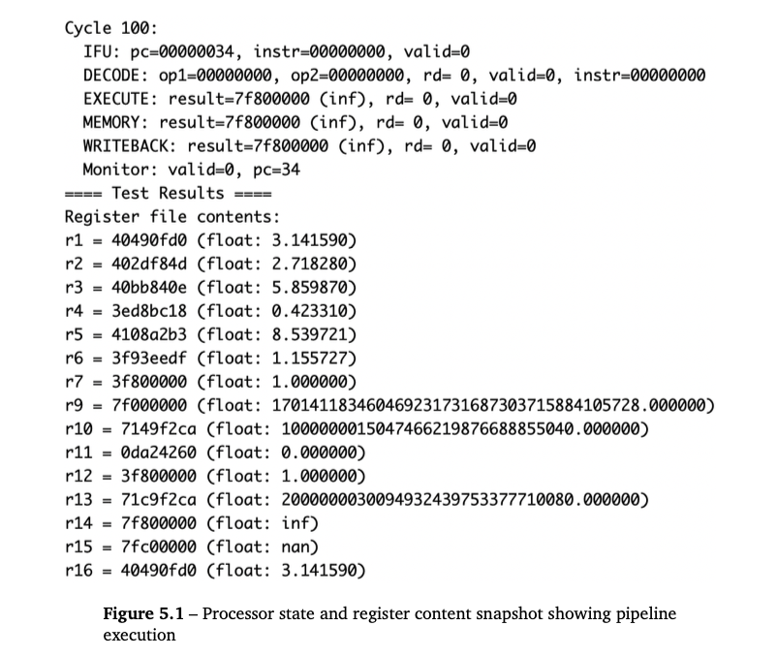
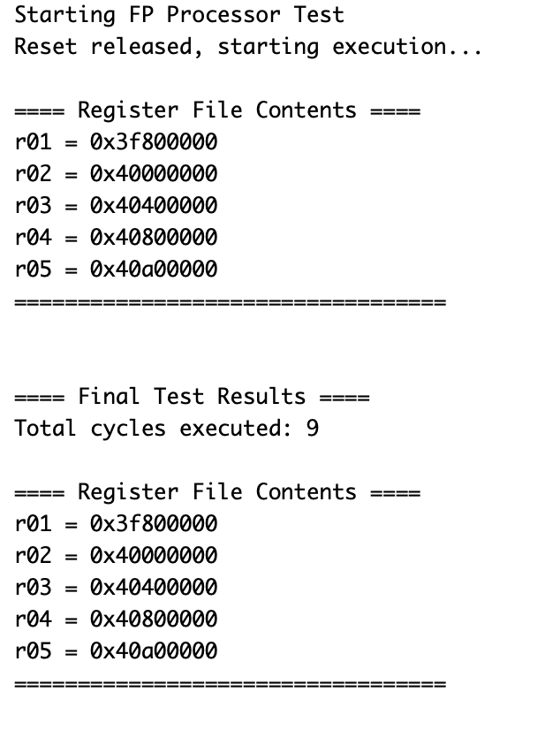
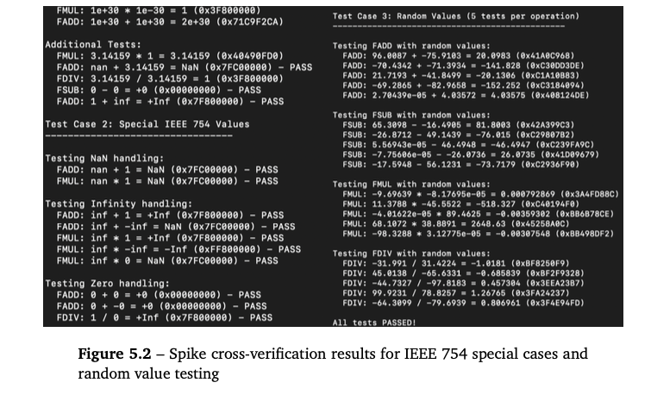
Functional Verification Results
Comprehensive Verification Approach
Ensures functional correctness and timing requirements
Proper pipeline functioning (Fetch → Decode → Execute → Memory → WB)
Testbench Portability
Equivalent test vectors for SystemC and RTL
Edge cases: overflow, underflow, precision loss scenarios
IEEE 754 compliance: Normal values, special cases (zero, infinity, NaN)
Division by zero → infinity (0x7f80_0000)
RISC-V Spike Cross-Verification
Golden reference using RISC-V ISA simulator

Slide 20
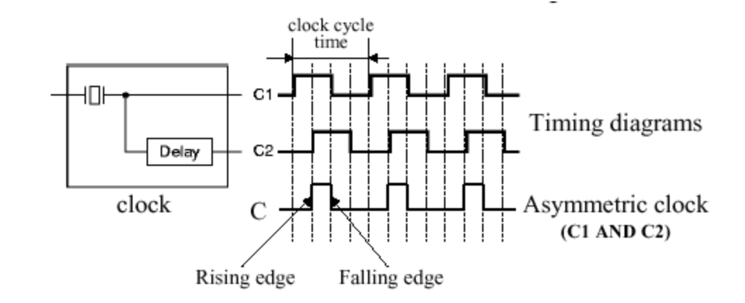
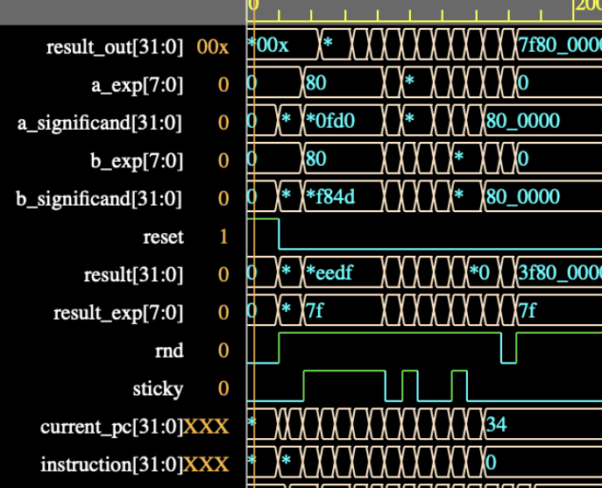
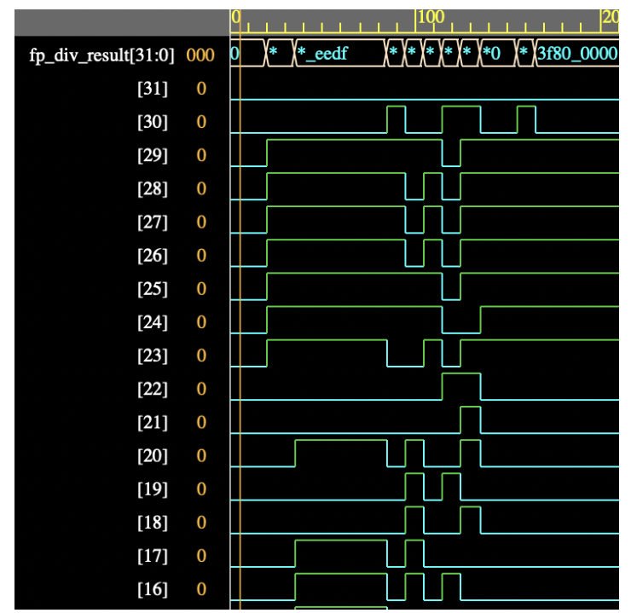
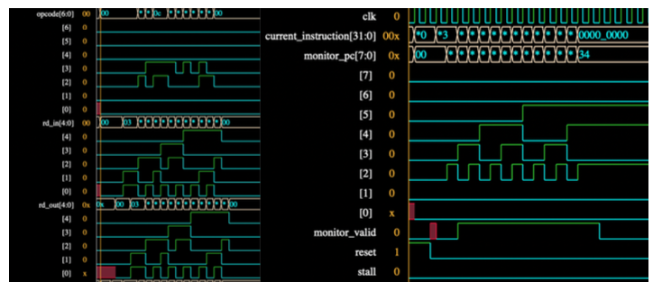
Functional Verification Results
Waveform Analysis
Signal propagation delays through pipeline stages
Data flow integrity from fetch to writeback
Floating-point arithmetic unit operation timing

Slide 21
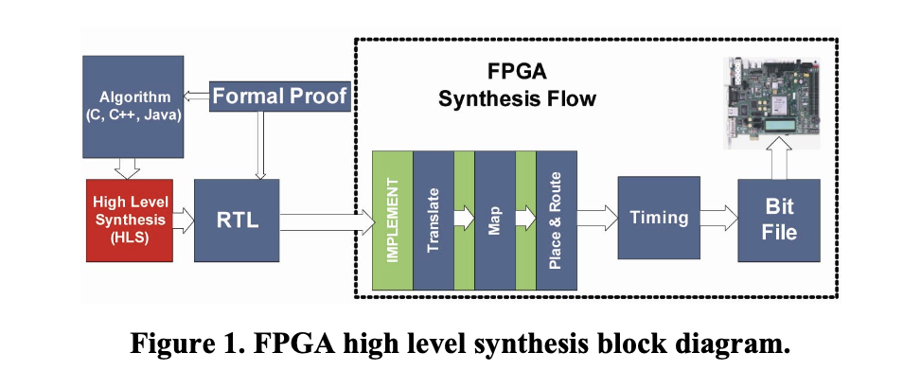
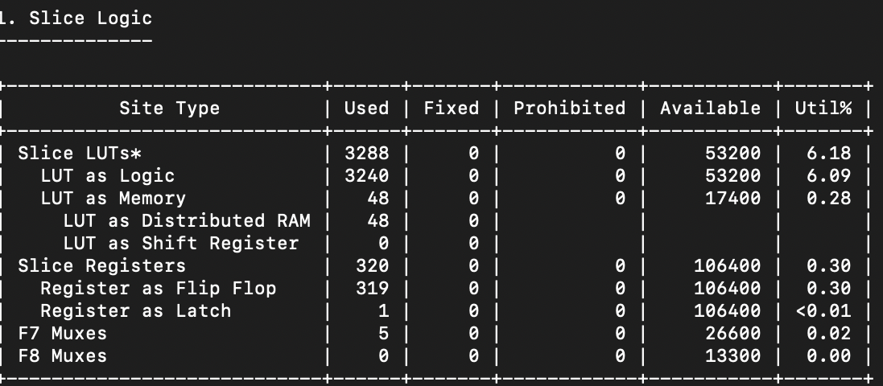
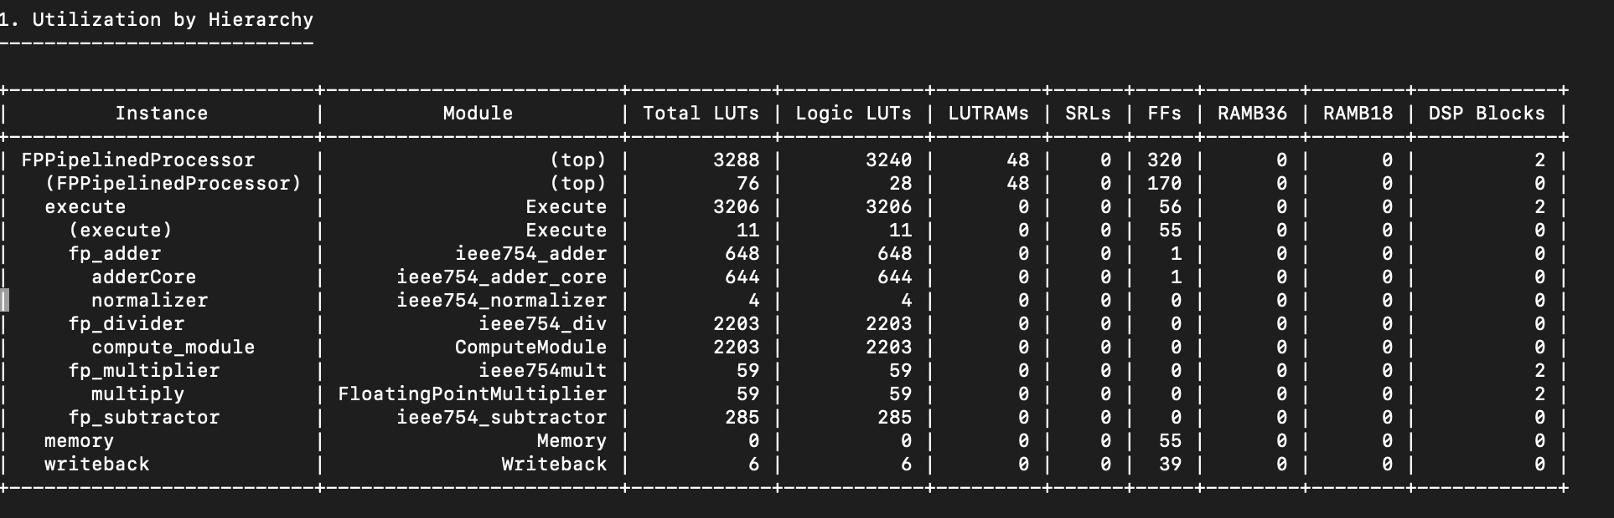
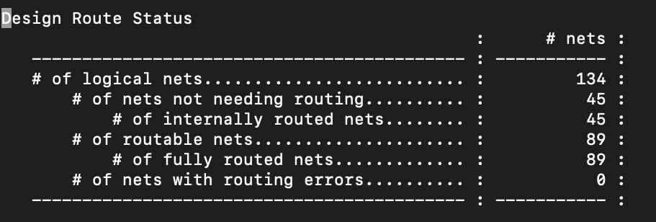
FPGA Implementation
Zybo Z7-20 with Xilinx Zynq-7000 SoC
FPGA Structure: Configurable Logic Blocks (CLBs) in 80×80 matrix format. Two parallel DSP48E1 SLICEs per CLB with 4× LUT-6 + 8× flip-flops
Processing System: Dual-core ARM Cortex-A9 + 28nm FPGA (2–4W power)
Implementation Steps
Translate: Merge netlists and constraints
Map: Assign logic to FPGA resources (LUTs, DSPs, FFs)
Place & Route: Physical locations + interconnect establishment
Bitstream Generation: Binary config file (.bit) successfully created using optimized DSP/logic resources for standalone PL design

Slide 22
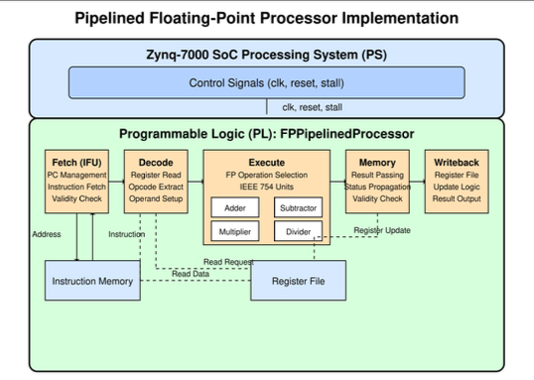
Conclusion
Key Contributions
Comprehensive Development Approach
Structured pathway: Architectural design → SystemC modeling → SystemVerilog → FPGA synthesis
Key Technical Achievements
IEEE 754-compliant FPU
HW-SW co-design: Resolved timing and exception handling challenges
Methodology Contributions
SystemC-based verification: Early functional validation at high abstraction level
Seamless HLS workflow: Automated RTL generation with reduced design cycle time
Hybrid testing approach: Multi-level verification (C, SystemVerilog, waveforms)
FPGA prototyping pathway: Scalable implementation for diverse platforms

Slide 23
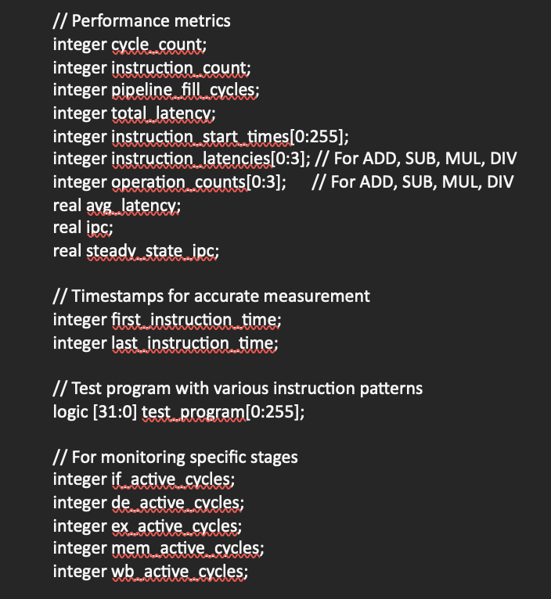
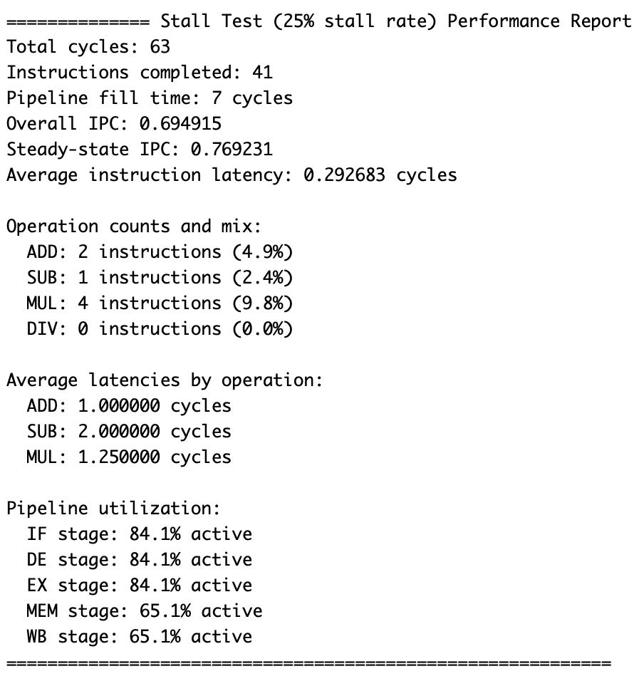
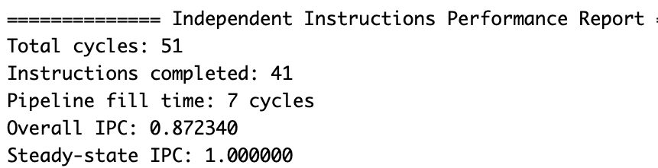
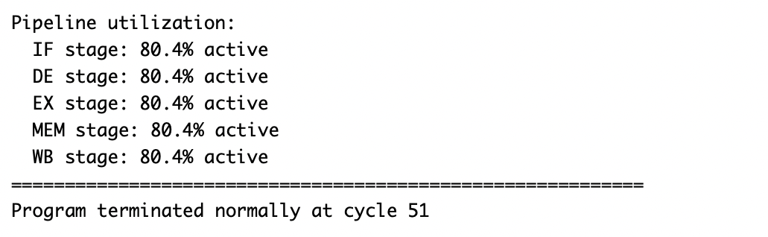
Conclusion
Future directions to solve current limitations
Precision Support: Limited to 32-bit single precision; scope for 16-bit and 64-bit formats
Pipelining: Need to study throughput, efficiency and IPC to improve pipeline for all ISA and SIMD
The pipeline doesn't model resource conflicts (e.g., only one FP operation can execute at a time). In reality, FP units are often shared, causing stalls.
Instruction Set: Only four basic operations implemented; can extend to full RV32F instruction set. Foundation for integer operations, branching, and complex instruction sets
Performance Focus: Prioritized functional correctness over performance optimization
Verification Scope: Simulation-based testing only; formal verification methods not explored
Platform Dependency: Xilinx Zynq-specific implementation due to time constraints

Slide 24
References
E. Oruklu, J. Hanley, S. Aslan, C. Dweik und F. Kilic, „System-on-Chip Design IEEE Computer Society, IEEE Standard for Floating-Point Arithmetic
B. Bailey, „The Evolution Of High-Level Synthesis,“ Semiconductor Engineering, Aug. 2020 (siehe S. 3).
D. Goldberg, „What Every Computer Scientist Should Know About Floating-Point Arithmetic,“ Oracle Documentation, Computing Surveys, 1991 (sieheS. 3).
M. K. Jaiswal und H. K. H. So, „Universal and Architecture-Efficient Fast Floating-Point Adder,“ IEEE Transactions on Very Large-Scale Integration (VLSI)
T. Grötker u. a., System Design with SystemC. Kluwer Academic Publishers,2002 (siehe S. 5).
M. Reshadi u. a., „Instruction Set Compiled Simulation: A Technique for Fast and Flexible Instruction Set Simulation,“ in Proceedings of the Design
Goossens,Guide to Computer Processor Architecture: A RISC-V Approach, with High-Level Synthesis (Undergraduate Topics in Computer Science) 2022.
Figures taken from https://www.cise.ufl.edu/~mssz/CompOrg/CDA-proc.html
L. H. Crockett u. a., The Zynq Book: Embedded Processing with the ARM Cortex-A9 on the Xilinx Zynq-7000 All Programmable SoC. Strathclyde
D. M. Russinoff, Formal Verification of Floating-Point Hardware Design: A Mathematical Approach. Cham, Switzerland: Springer Nature Switzerland 2019
Intel Corporation, Intel SystemC Compiler User Guide (Version 1.6.13),
S. Palnitkar, Verilog HDL: A Guide to Digital Design and Synthesis, 2nd. Prentice Hall, 2003 (siehe S. 21, 24).
Xilinx Inc., 7 Series FPGAs Data Sheet: Overview, DS180 (v2.6), Feb. 2018
Digilent Inc., Zybo Z7-20 Datasheet, 2017
Digital Circuits

